Slide 1

Objectives:
meaning of equilibrium price
meaning and consequence of disequilibrium
meaning of ‘surplus’ and ‘shortage’
Causes of change in equilibrium price

Slide 2
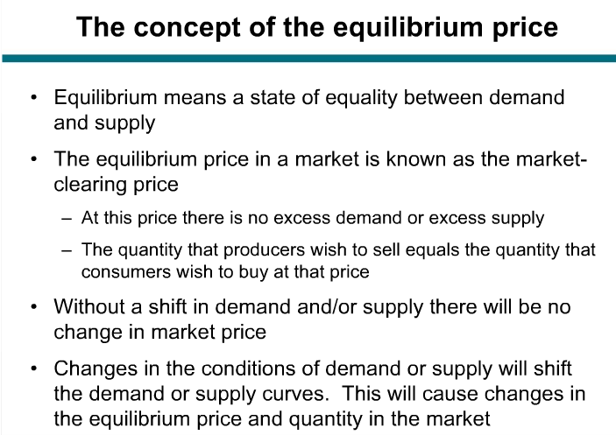

Slide 3
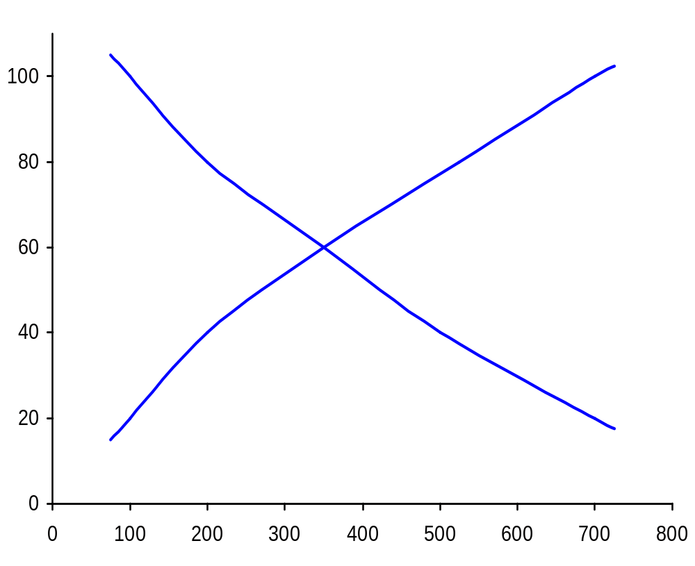
The determination of market equilibrium
(potatoes: monthly)
E
e
Supply
D
d
C
c
Price (pence per kg)
b
B
a
A
a
A
Demand
Quantity (tonnes: 000s)

Slide 4
The determination of market equilibrium
(potatoes: monthly)
E
e
Supply
D
SURPLUS
d
(330 000)
C
c
Price (pence per kg)
b
B
a
A
Demand
Quantity (tonnes: 000s)

Slide 5
The Determination of Price
Equilibrium price and output
  response to shortages and surpluses
  significance of “equilibrium”
Demand and supply curves
  effect of price being above equilibrium
    surplus → price falls
  effect of price being below equilibrium
    shortage → price rises

Slide 6
The determination of market equilibrium
(potatoes: monthly)
E
e
Supply
D
d
C
c
Price (pence per kg)
b
SHORTAGE
B
(300 000)
a
A
Demand
Quantity (tonnes: 000s)

Slide 7
The Determination of Price
Equilibrium price and output
  response to shortages and surpluses
  significance of “equilibrium”
Demand and supply curves
  effect of price being above equilibrium
    surplus → price falls
  effect of price being below equilibrium
    shortage → price rises
  equilibrium: where D = S

Slide 8
The Determination of Price
Effects of shifts in the demand curve
  movement along S curve and new D curve
    rise in demand (rightward shift) → P rises
    fall in demand (leftward shift) → P falls

Slide 9
Effect of a shift in the demand curve
P
S
g
P_{e1}
D₂
D₁
O
Q_{e1}
Q

Slide 10
Effect of a shift in the demand curve
P
S
i
P_{e2}
g
h
P_{e1}
D₂
D₁
O
Q_{e1}
Q_{e2}
Q

Slide 11
The Determination of Price
Effects of shifts in the demand curve
  movement along S curve and new D curve
    rise in demand (rightward shift) → P rises
    fall in demand (leftward shift) → P falls
Effects of shifts in the supply curve
  movement along D curve and new S curve
    rise in supply (rightward shift) → P falls
    fall in supply (leftward shift) → P rises

Slide 12
Effect of a shift in the supply curve
P
S₁
g
P_{e1}
D
O
Q_{e1}
Q

Slide 13
Effect of a shift in the supply curve
P
S₂
S₁
g
P_{e1}
D
O
Q_{e1}
Q

Slide 14
Effect of a shift in the supply curve
P
S₂
S₁
k
P_{e3}
j
g
P_{e1}
D
O
Q_{e3}
Q_{e1}
Q

